Slide 1

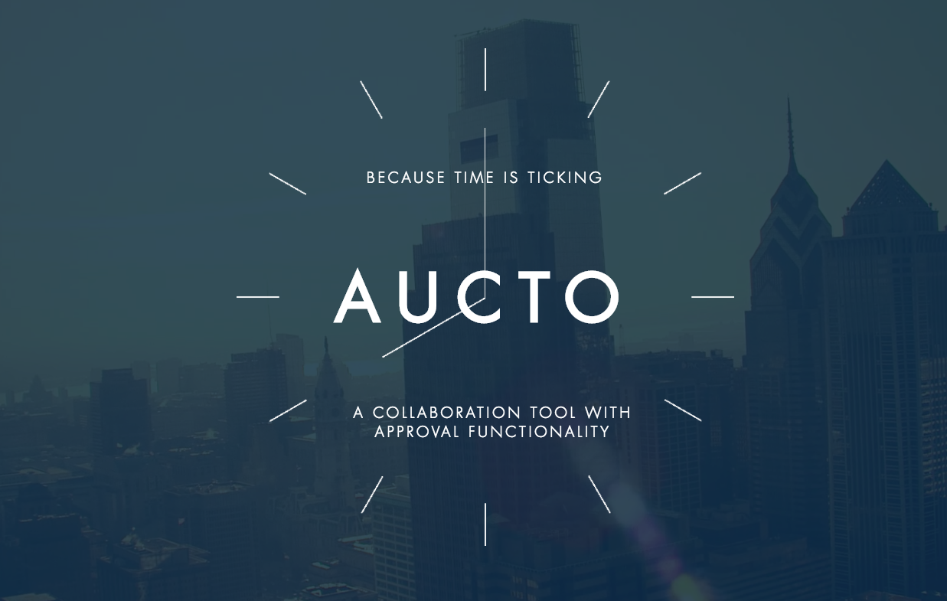
Team Auctoritatis – Pitch – Solution to Problem 1 – The Stamp of Approval
5 August 2017

Slide 2
Which approvals are required?
Who in the organisation is authorised to give the required approvals?
How is the contract approved?
What is the process?

Slide 3
What are the problems?
The problems with the current process for determining which approvals are required are:
Inefficient
Time Consuming / Slow
Risk - Could be approved by the wrong people
Uncertainty / Stress

Slide 4
Solution - Aucto
Aucto is a collaboration tool with approval functionality.
It helps users navigate the approval process in a simple and streamlined manner.
Save Money
Save Time
Reduce Risk
Create an audit trail

Slide 5
Demo
The Aucto user interface

Slide 6
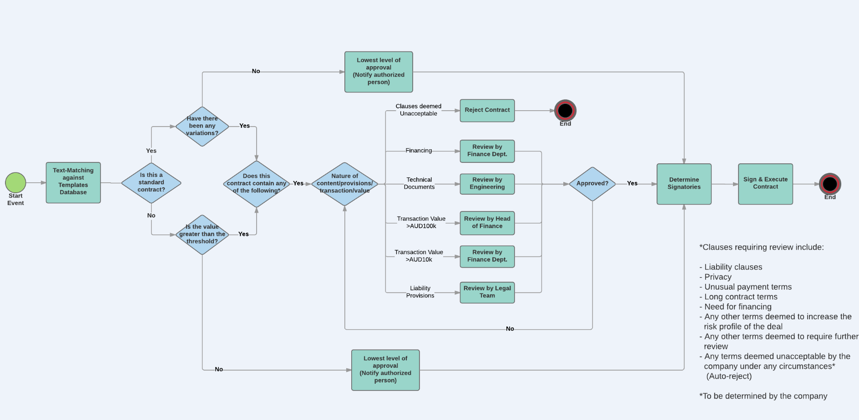
Workflow – Decision tree
Notes:
Identify those deals that sit in between the lowest level of risk at which a contract needs to be reviewed and the highest level
Too low a risk -> pre-approve via business rule
Too high a risk -> pre-reject via business rule

Slide 7
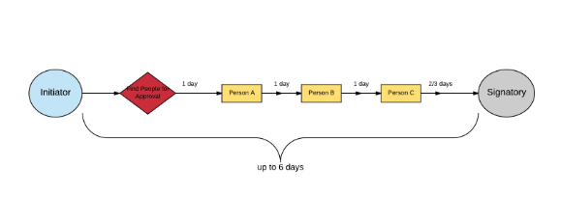
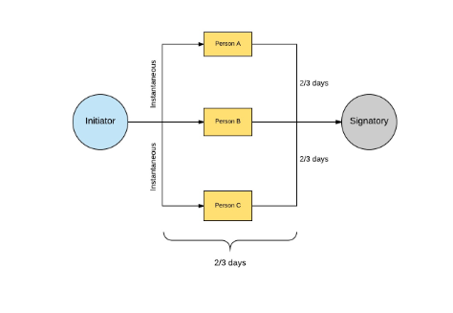
The process before and after
Before:
After with Aucto:
Notes:
Parallel processing - rather than serial decision making
Basically gets rid of bottlenecks

Slide 8
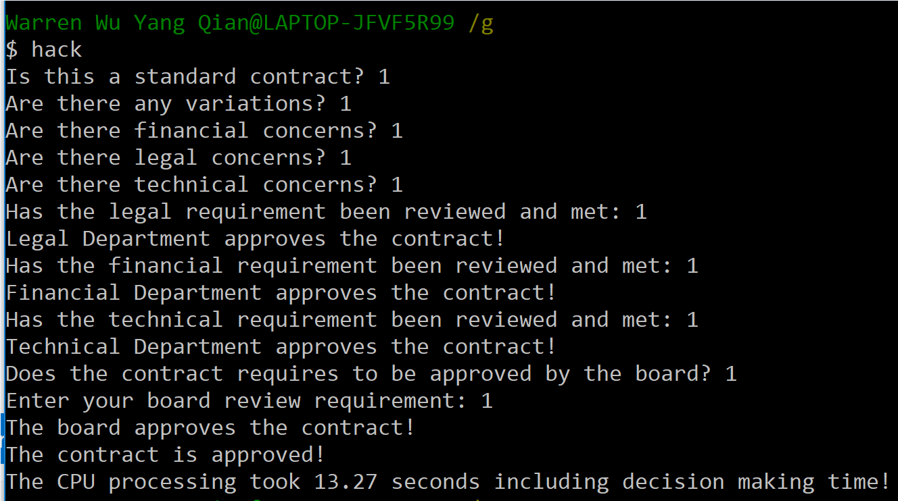
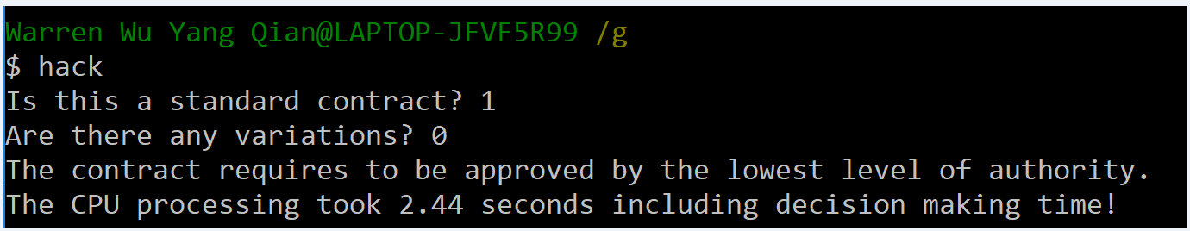
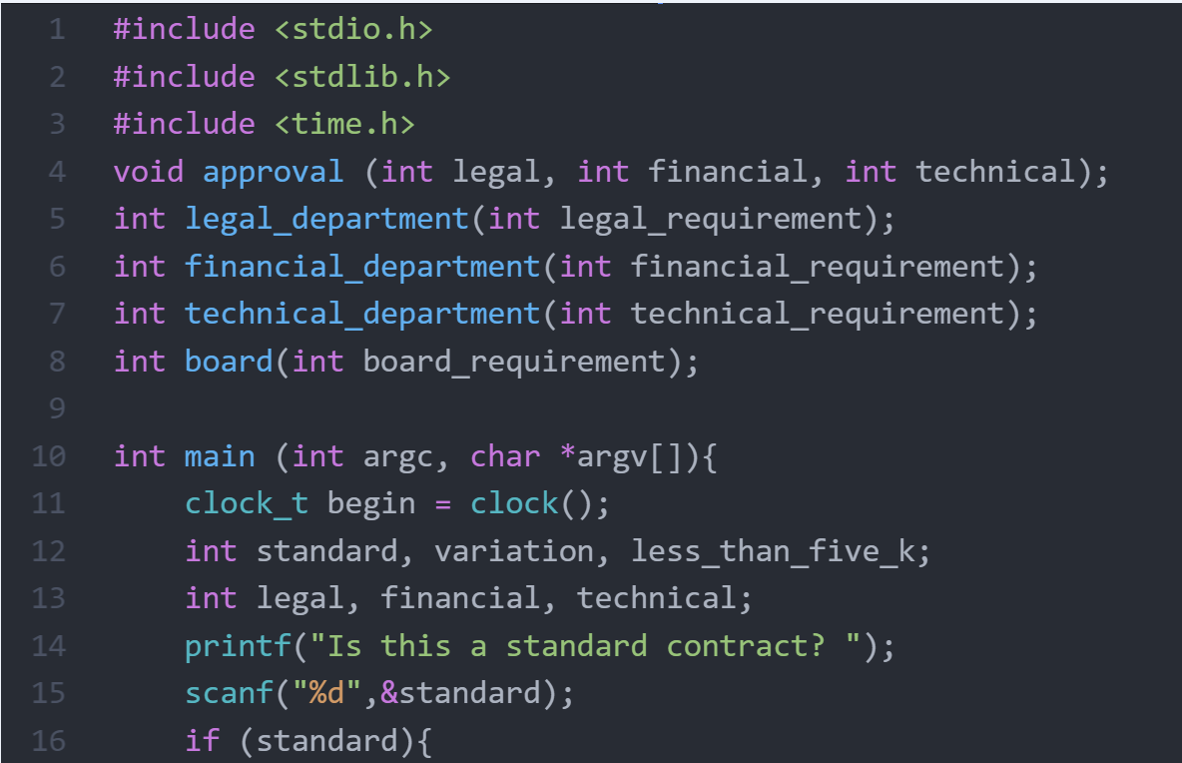
The Aucto Code
With Aucto finding the right person and filling the questionnaire takes only a few seconds using the Aucto code

Slide 9
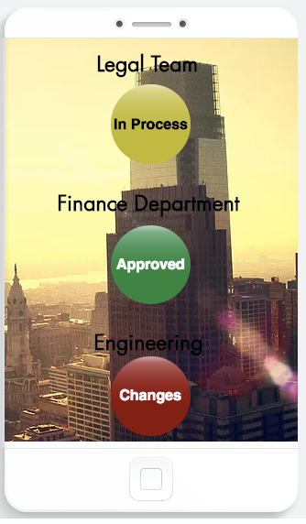
What Aucto can do?
User friendly–
Approval of the contract
is a few clicks away
Adaptability –
Adapt the questionnaire and code to the
type of contracts your business uses
Allows for collaborative review -
The contract will not be approved until all
relevant departments have reviewed the
contract

Slide 10
What can Aucto do for YOU?

Slide 11
Appendices

Slide 12
Value Proposition
Costs savings - in term of man hours.
Example: a company has 1000 POs per month, which take two hours each to decide who needs to sign-off.
If we can save one hour per PO – that would mean 1000 fewer man hours.
Unbundling – pay only for the functionalities you want. Only pay for what you use.

Slide 13
Business Model
We take a fee based on subscriptions from companies based on the number of users.
$990,000
$30
33,000
NUMBER OF USERS AVERAGE FEE REVENUE
Notes:
Reasonable price point – compare Zenefits, Sharepoint - $5 p/ m lowest package

